Slide 1
Visual Transformers (ViTs)
Krzysztof Król

Slide 2
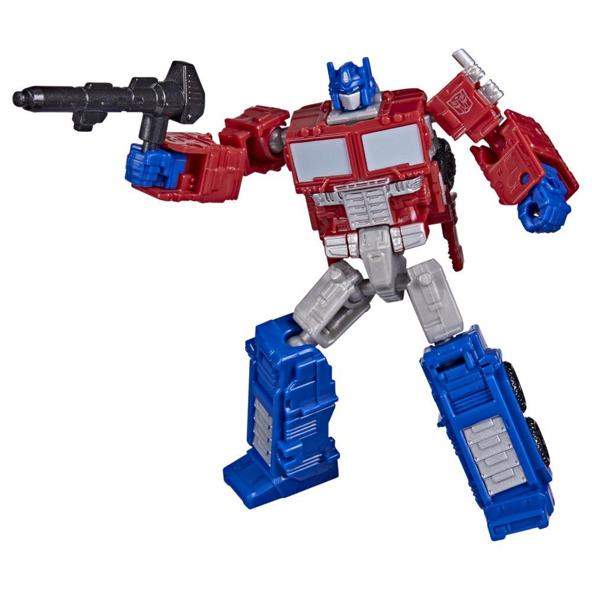

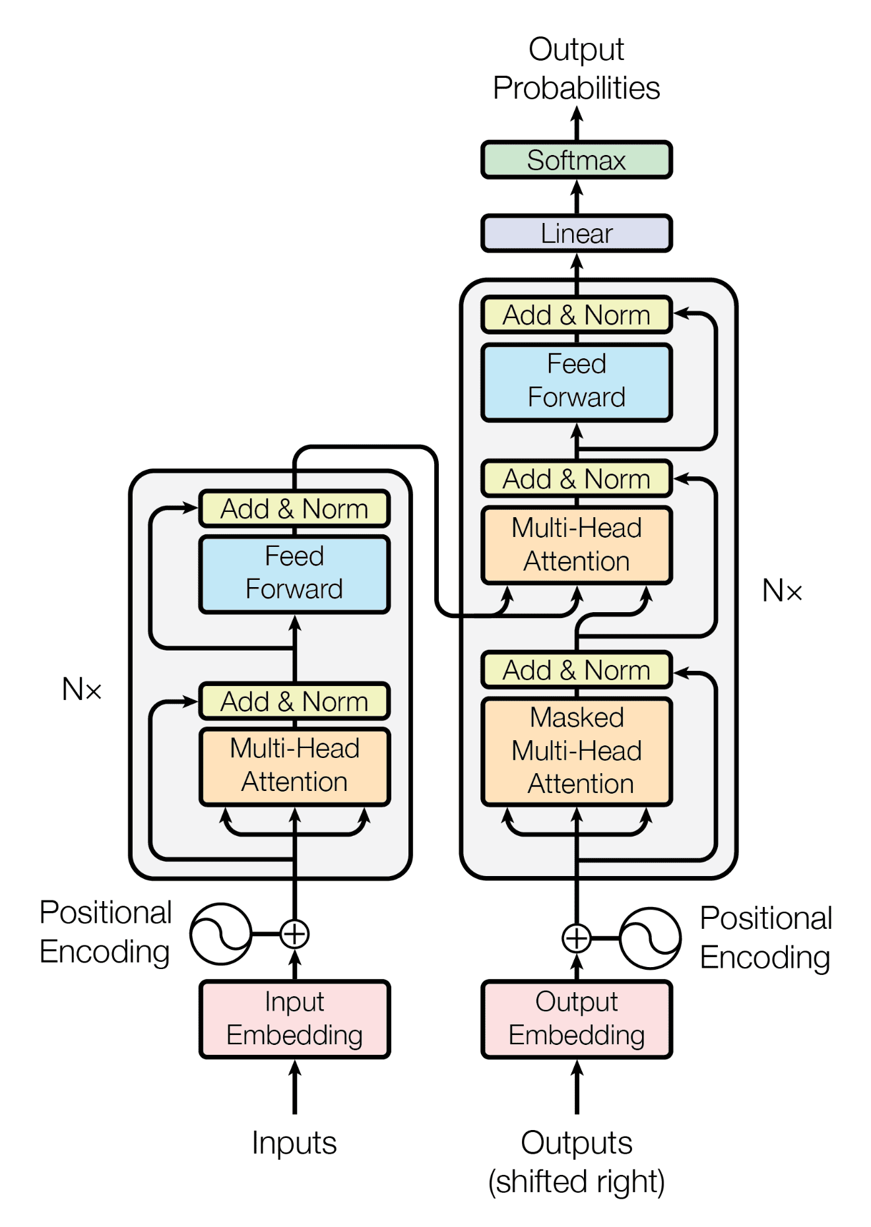
But what even are “transformers”?
A deep learning architecture
Based on the attention mechanism
Scalable and parallel-izable by default
Multi-modal (text, image, sound etc.)
Variants:
encoder-only (BERT)
decoder-only (GPT)
encoder + decoder (Translation models)

Slide 3
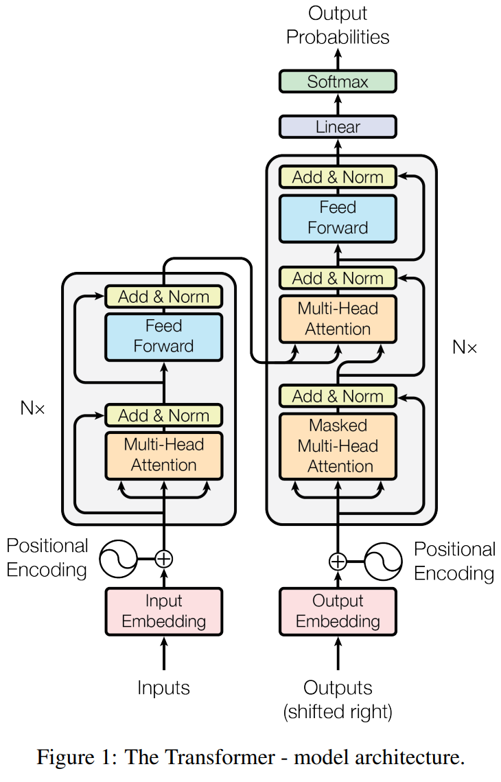
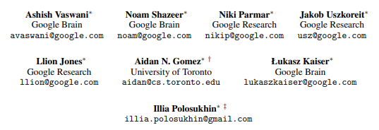
History - “Attention is all you need”
published in 2017
mostly google-authored
unassuming title
architecture almost unchanged since then

Slide 4
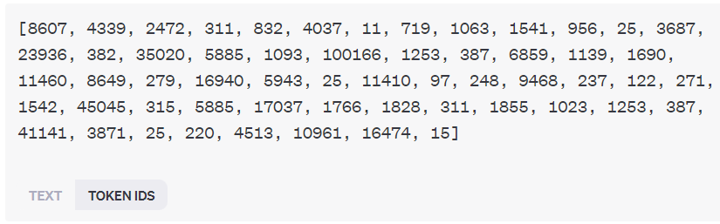
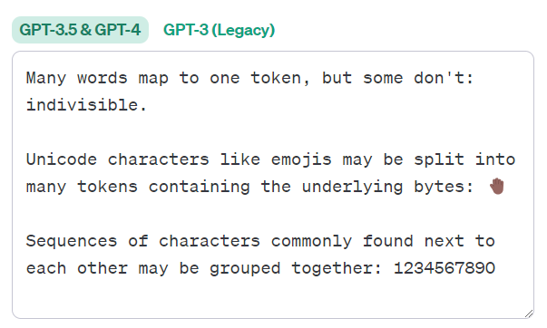
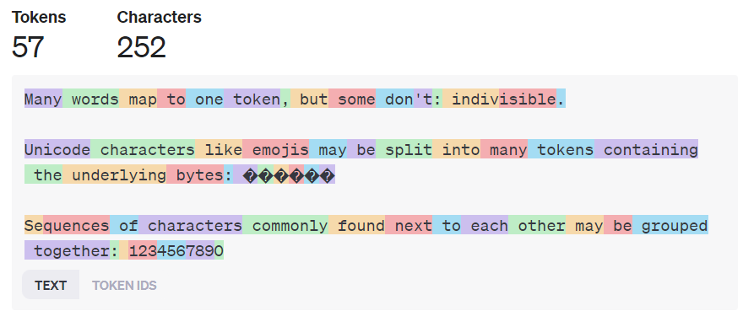
Tokens
Represented as a node in a directional computation graph.
The most fundamental unit of input. They can be:
Text - character, sub-word part, word, sentence
Image - pixel, image patch, row/column of pixels
Sound - single sample, sound patch

Slide 5
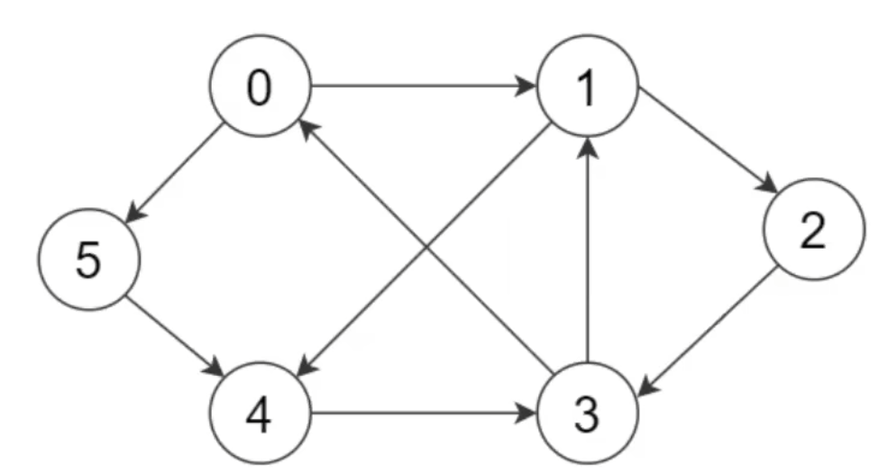
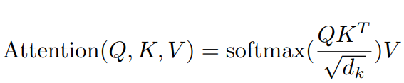
Attention
Mechanism defining how nodes (tokens) “communicate” with each other.
From a node’s POV:
Query (Q) - what i’m looking for
Key (K) - what i have
Value (V) - what i will communicate

Slide 6
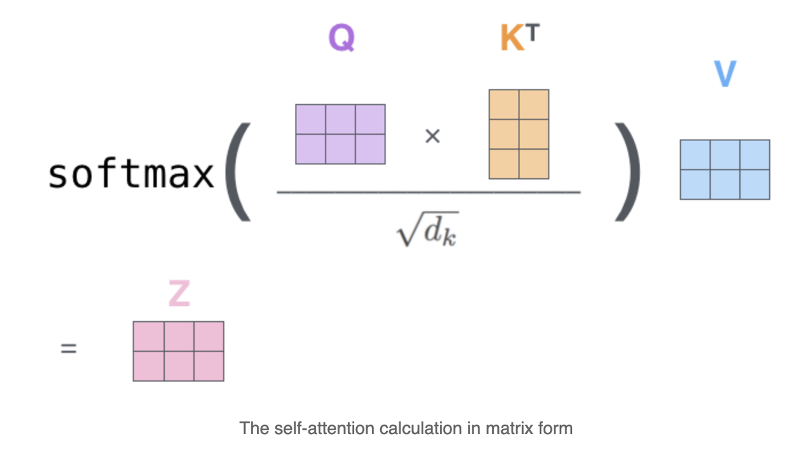

Slide 7
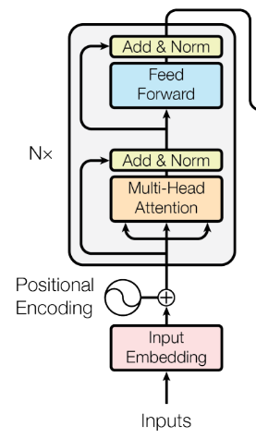
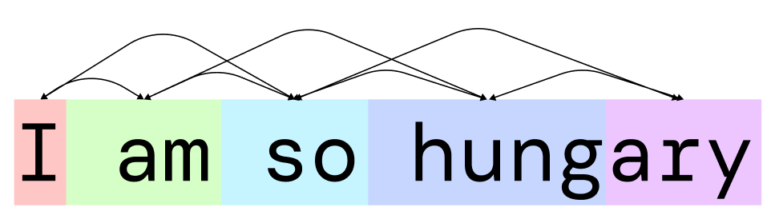
Encoder
All nodes communicate with each other.
0 1 2 3 4

Slide 8
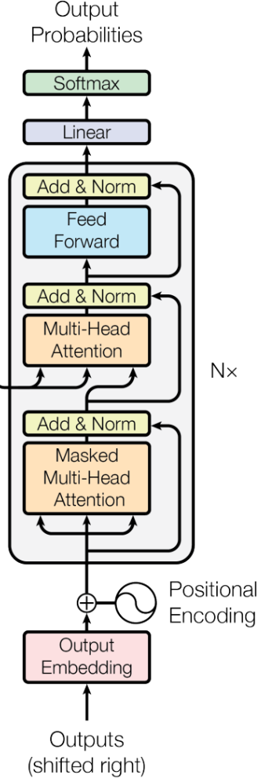
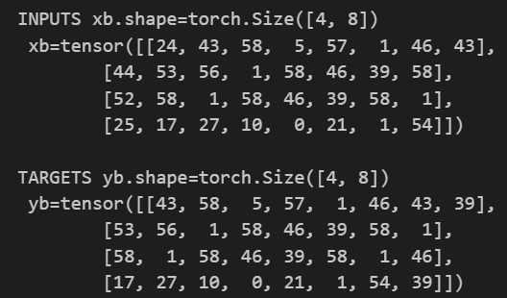
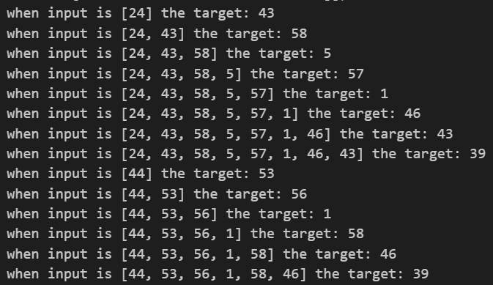
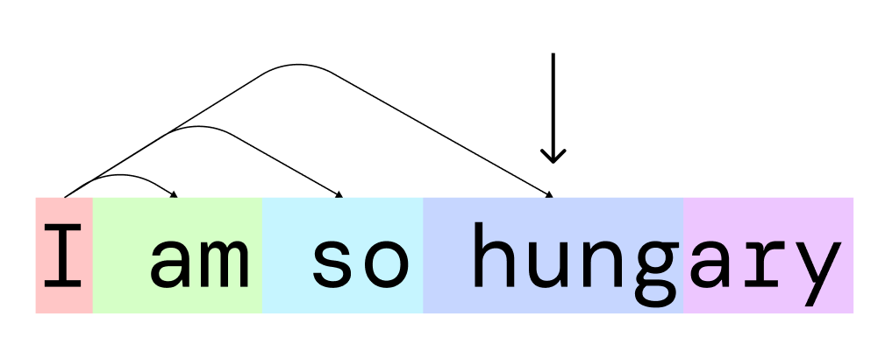
Decoder

Slide 9
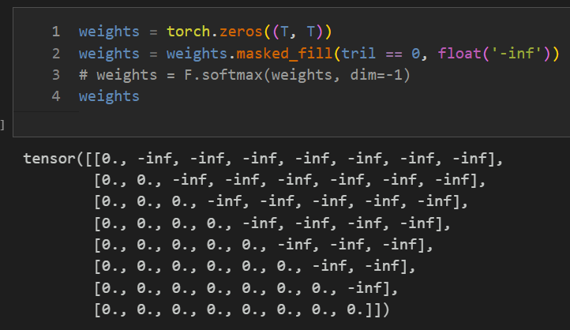
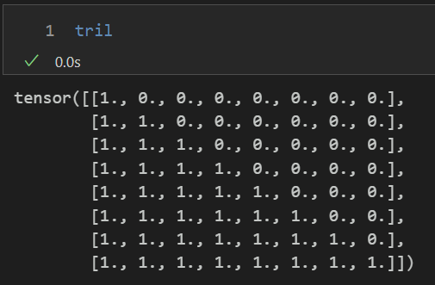
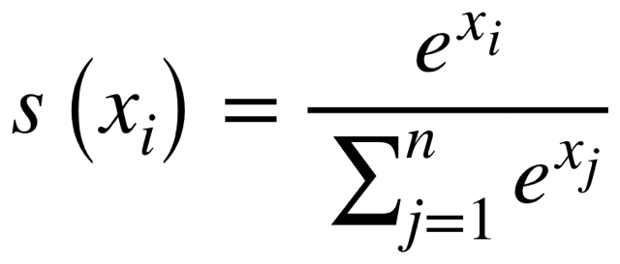
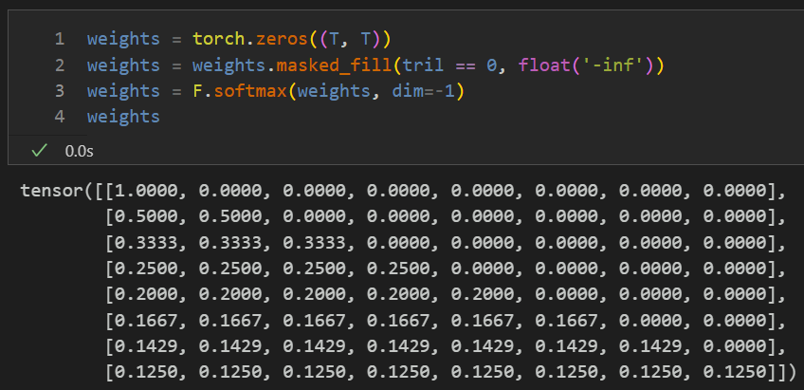
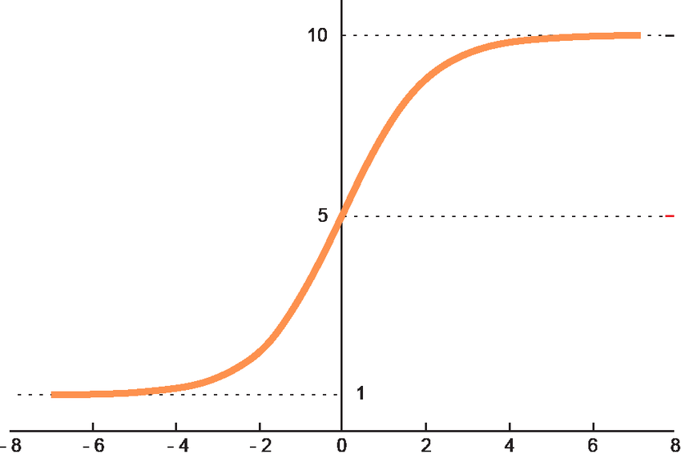
Masked Multi-Head attention
Softmax

Slide 10
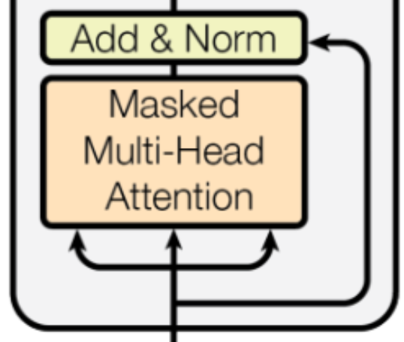
Residual pathways and layer normalization
Layer
normalization
Residual pathways:
Reduce overfitting in a single step
stabilizes gradient descent
Layer normalization:
Guarantees mean = 0 and variance = 1
reduces covariance shift (dependencies between each layer)
Residual
Pathway

Slide 11
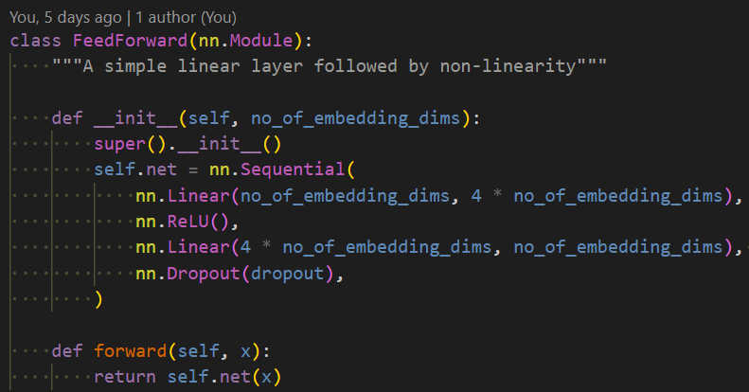

Feed forward = Old friend: MLP

Slide 12
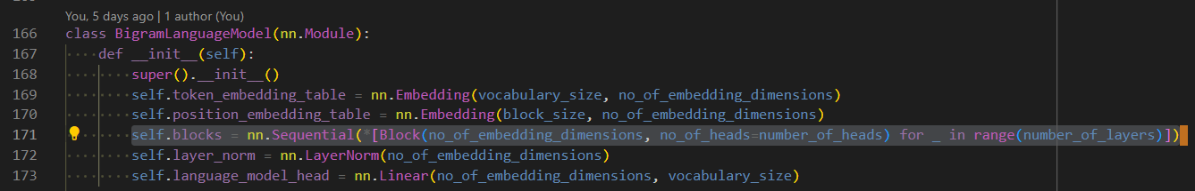
How to scale?
Just add more blocks…

Slide 13
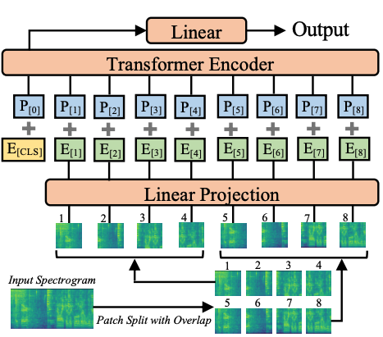
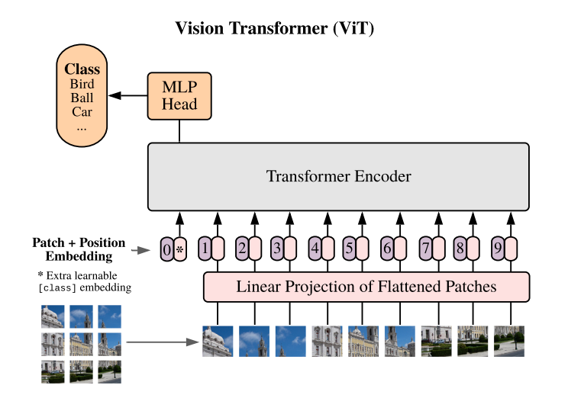
Different input domains
Just patch it, encode it, embed it and throw it in a transformer…

Slide 14
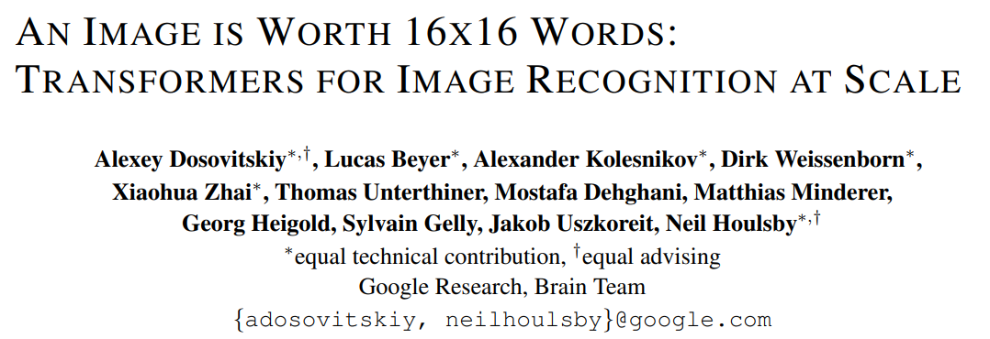
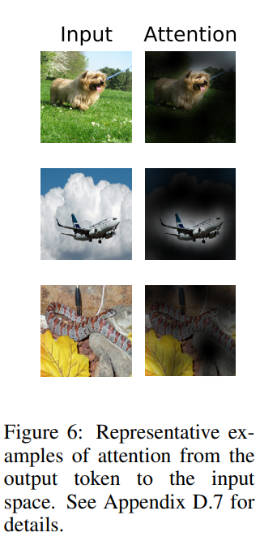
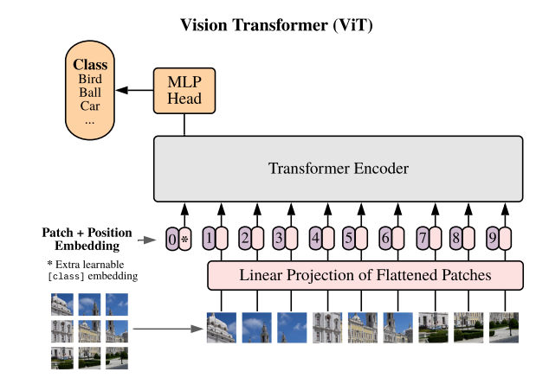

Slide 15
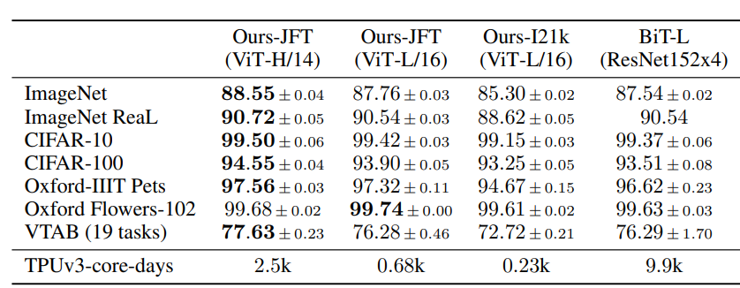
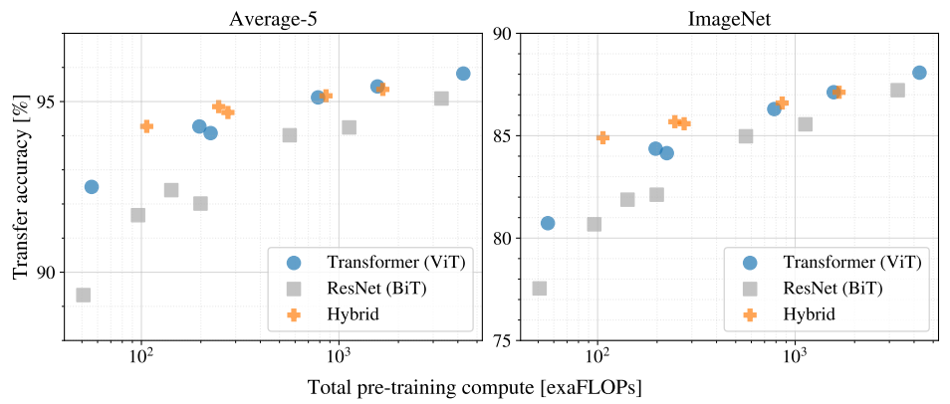
Some results:

Slide 16
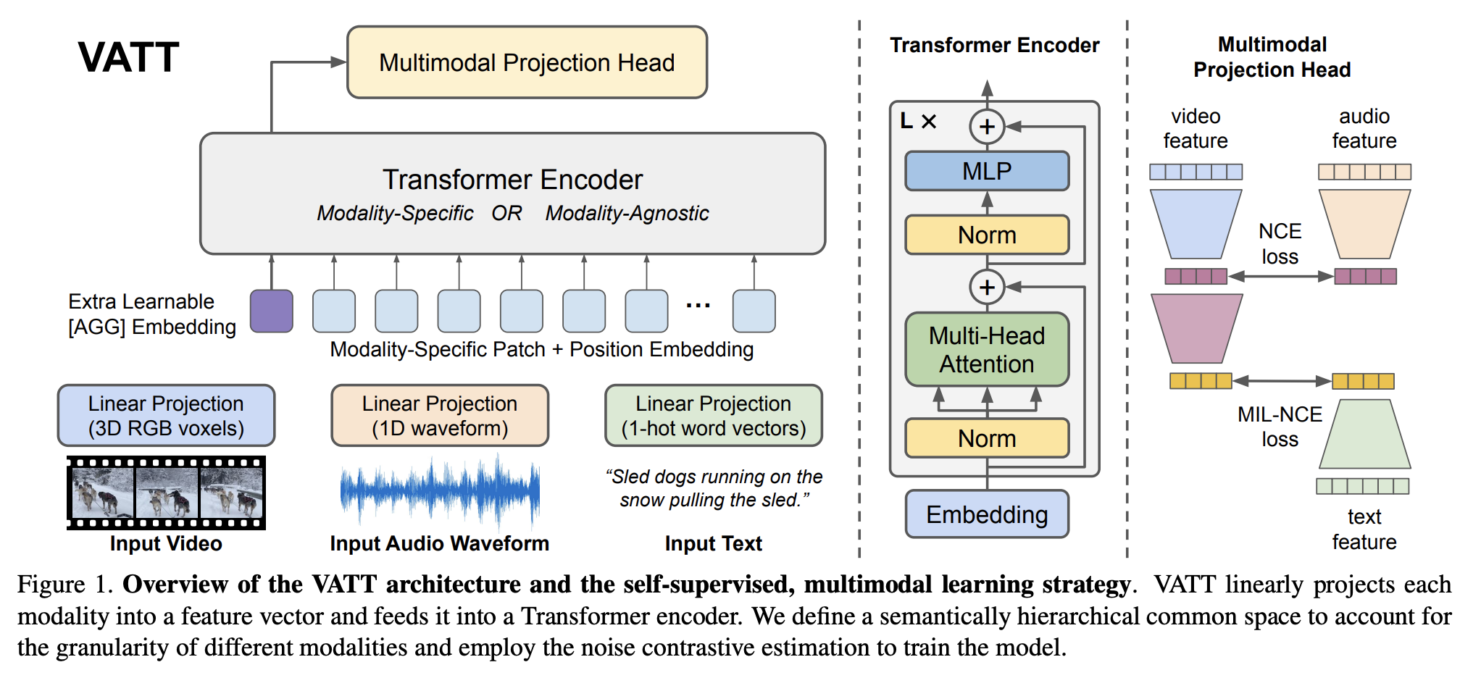
Bonus - Multi-modality

